Slide 1

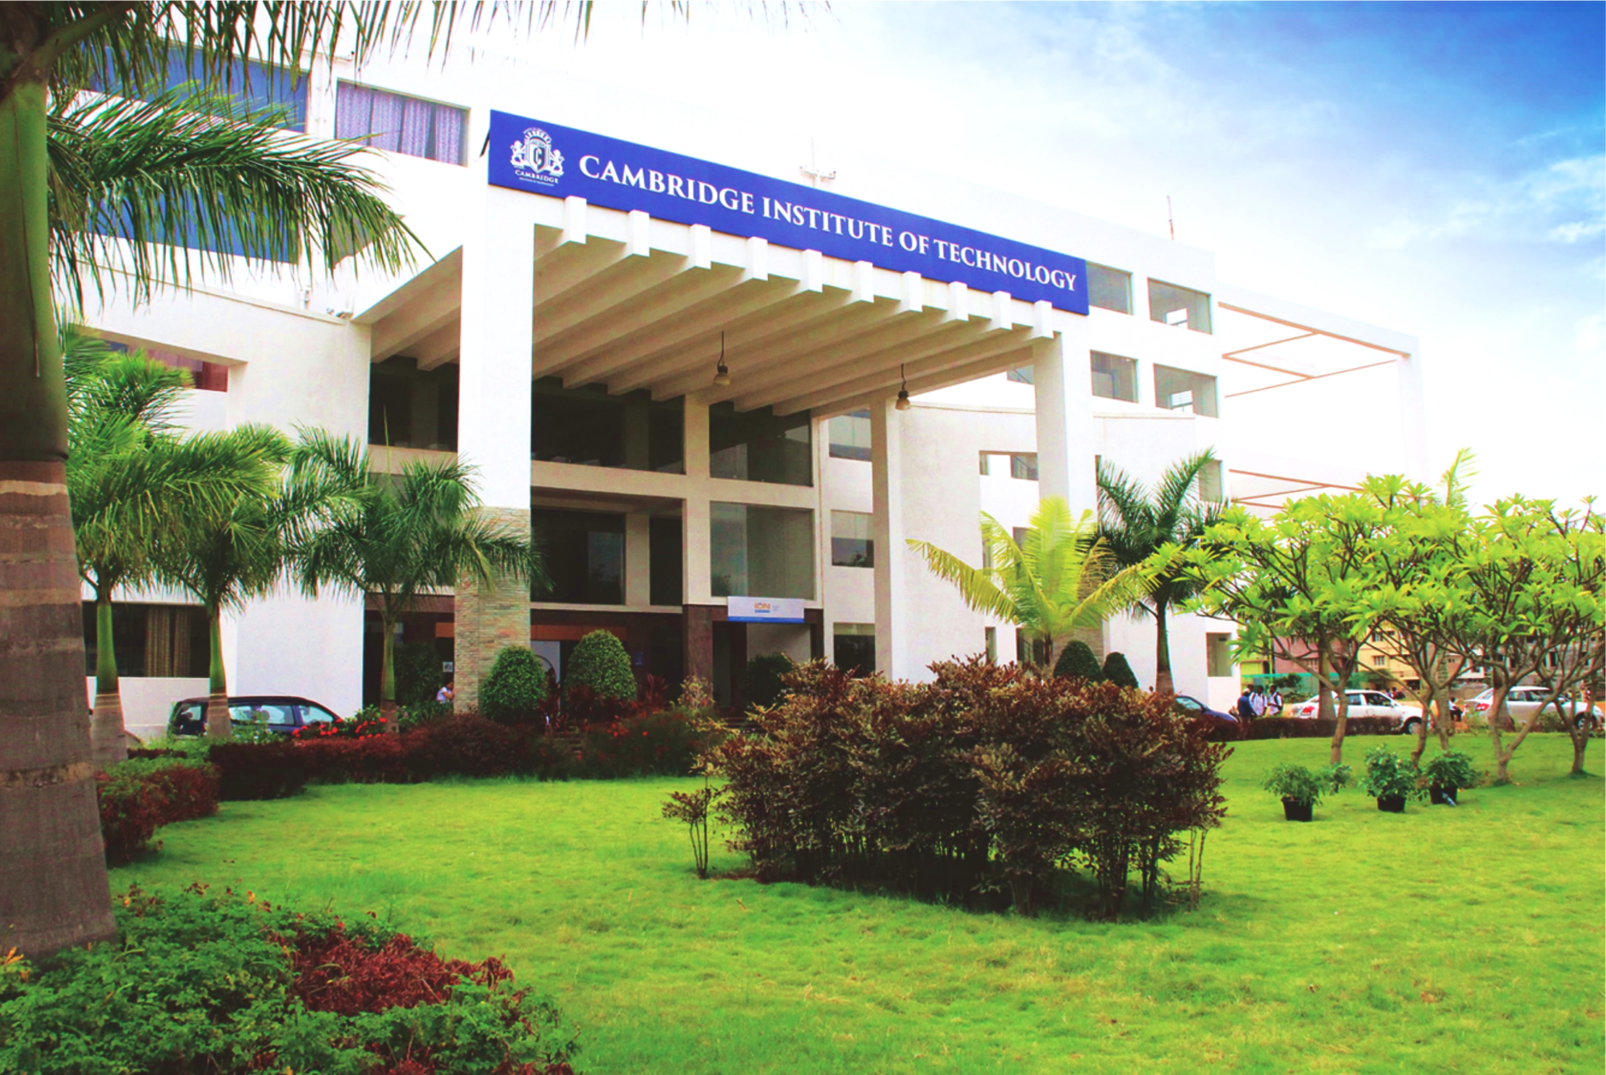
www.cambridge.edu.in
Project Work Phase – II
Subject Code:18AIP83
Project Name:
Car price prediction
Presented By :
P. RAAGANJANI (1CD21AI039)
POOJITHA. P (1CD21AI040)
Department of Artificial Intelligence and Machine Learning

Slide 2
Introduction
The project aims to develop a web application for predicting car prices based on various input parameters such as car company, model, year of manufacture, fuel type, and kilometers driven. The application leverages Flask, a Python-based web framework, to handle user interactions and prediction requests. It integrates a pre-trained linear regression model, utilizing data from a cleaned car dataset, to provide accurate price predictions.
The application starts by allowing users to select car attributes through a user-friendly interface. Upon form submission, the application computes the predicted price using the loaded machine learning model. This model, trained on historical car data, captures relationships between input features and car prices, ensuring robust predictions. Key features include data preprocessing, model training using supervised learning techniques, and deployment of the model within a Flask environment.
Department of Artificial Intelligence and Machine Learning www.Cambridge.edu.in

Slide 3
Literature Survey
SL NO | PAPER TITLE | JOURNAL NAME | DESCRIPTION | PROS | CONS
1 | Car price prediction | Github.com | This Flask-based project demonstrates the integration of machine learning with web development to create a practical application for predicting car prices. It combines backend processing with frontend user interaction through a simple yet effective web interface, offering real-time predictions based on user inputs. | User-Friendly Interface. Accurate Predictions Integration with Flask Scalability and Flexibility Real-Time Feedback | Model Limitations Data Availability and Quality Security Considerations Performance Optimization Model Maintenance
2 | Linear Regression | sciencedirect.com | Linear regression relates predictor variables and outcome variables, such as gene copy numbers and the level of a biomarker. The assumed linearity of the relationships makes the models convenient both mathematically and computationally. And since the data can be arbitrarily transformed beforehand, such as by including polynomials of the copy numbers as predictor variables or by replacing the level of the biomarker in the outcome variable by its logarithm, linear regression can also effectively model non-linear relationships. | Simplicity Interpretability Efficiency Linearity Minimum Collinearity Predictive Performance | Assumption of Linearity Sensitivity to Outliers Multicollinearity Overfitting Homogeneity of Variance Normality of Errors Independence of Errors
Department of Artificial Intelligence and Machine Learning www.Cambridge.edu.in

Slide 4
Problem Statement
create a user-friendly interface where users can input specific car details and receive an instant price estimation. This application will utilize a pre-trained linear regression model, trained on a cleaned and curated dataset of historical car sales data, to provide reliable predictions. The model's effectiveness will be assessed through accuracy metrics and validation against real-world pricing data.
Key challenges include:
Ensuring the accuracy and reliability of price predictions across a diverse range of car brands and models.
Handling user input validation and error handling to enhance user experience.
Integrating the machine learning model seamlessly into a Flask web framework for real-time predictions.
Department of Artificial Intelligence and Machine Learning www.Cambridge.edu.in

Slide 5
Objectives
You are required to model the prices of cars with the available independent variables. It will be used by management to understand how exactly the prices vary with the independent variables. They can accordingly manipulate the design of the cars, the business strategy etc. to meet certain price levels. Further, the model will be good for management to understand the pricing dynamics of the new market.
Develop a Web Application
Integrate Machine Learning Model
Data Handling and Preprocessing
User Interface Design
Prediction and Display
Error Handling and Validation
Deployment and Testing
Documentation and Future Recommendations
Evaluation and Validation
Department of Artificial Intelligence and Machine Learning www.Cambridge.edu.in

Slide 6
Methodologies
Step 1 : Understand the Business Problem.
Step 2 : Import all the libraries and set up all the requirements that you will need.
Step 3: Import the data set and check the following
- dimension of the dataset.
- data types.
- Missing value available in the dataset.
- Descriptive statistics of data and write the observation.
Step 4: Data Cleaning
- Create the column as 'CompanyName' using 'CarName' Column. List down the unique 'CompanyName’.
- Check the correctness of data in the 'CompanyName' column.
- Check the duplicate data in the dataset.
Department of Artificial Intelligence and Machine Learning www.Cambridge.edu.in

Slide 7
Step 5: Feature Engineering: Extract meaningful features from the dataset that can contribute to accurate price predictions. Convert categorical variables (e.g., car company, model, fuel type) into numerical representations using techniques like one-hot encoding.
Step 6: Model Selection: Choose an appropriate machine learning algorithm for regression tasks. In your case, a linear regression model is already selected and trained.
Step 7: Model Training: Train the linear regression model on the cleaned dataset. Utilize Scikit-learn for model training and evaluation. Cross-validate the model to ensure robustness and prevent overfitting.
Step 8: Web Application Development:
-Framework Selection:
-User Interface Design:
-Form Handling:
-Integration with Machine Learning Model
Department of Artificial Intelligence and Machine Learning www.Cambridge.edu.in

Slide 8
Step 9: Error Handling and Validation:
-Input Validation
-Error Handling
Step 10: Deployment and Testing:
-Local Deployment
-Testing
-Performance Evaluation
Department of Artificial Intelligence and Machine Learning www.Cambridge.edu.in

Slide 9
Understand the business problem
Import Libraries
Import the dataset
System Architecture
Data Cleaning
Feature Engineering
Model Selection
User Interface Design
Model Training
Frame Work Selection
Web Application Development
Integration with Machine Learning Model
Form Handling
Error handling and Validation
Deployment and Testing
Department of Artificial Intelligence and Machine Learning www.Cambridge.edu.in

Slide 10
Tools and Technologies
Click-7.1.2
Flask-1.1.2
Flask-Cors-3.0.8
Gunicorn-20.0.4
Jinja2-2.11.2
Joblib-0.15.1
Numpy-1.18.5
Pandas-1.0.4
pickle-mixin-1.0.2
python-dateutil-2.8.1
pytz-2020.1
scikit-learn-0.22.2
six-1.15.0
sklearn-0.0

Slide 11
Hardware Technologies
A typical PC or workstation used by data scientists may include a multi-core CPU, 16-32 GB of RAM, and an SSD for fast data access.
CPU: Multi-core processors with high clock speeds.
GPU: Graphics Processing Units (such as NVIDIA GPUs) for accelerated machine learning computations.
Memory: High memory capacity (64 GB or more) to handle large datasets.
Storage: High-speed SSDs or NVMe storage for fast read/write operations.

Slide 12
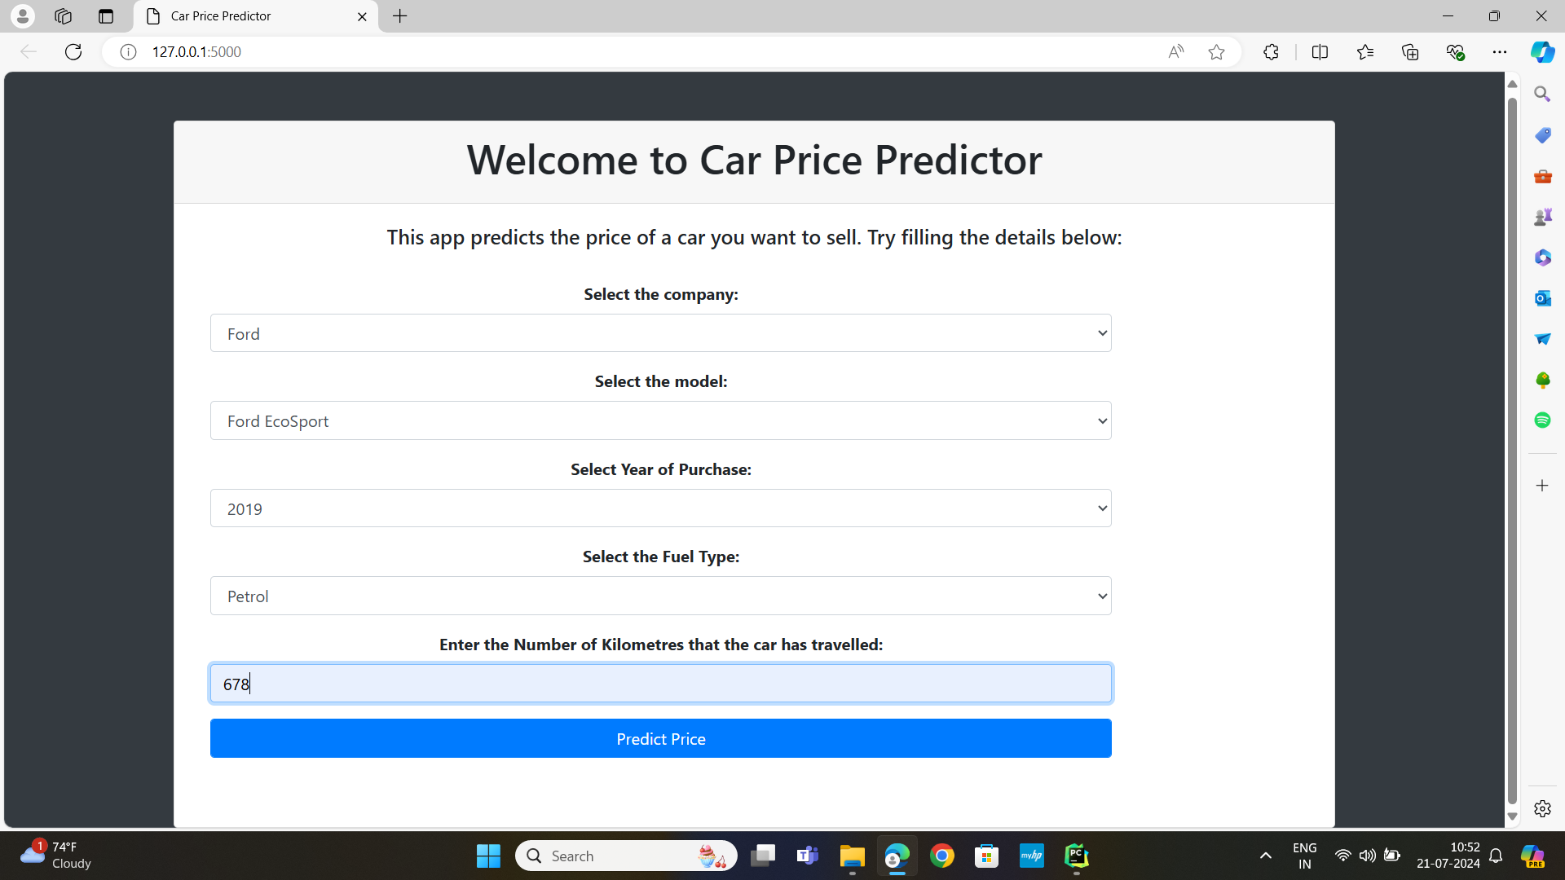
Result
The result of this project is a functional web application that allows users to predict car prices based on input parameters such as car company, model, year of manufacture, fuel type, and kilometers driven.
Department of Artificial Intelligence and Machine Learning www.Cambridge.edu.in

Slide 13
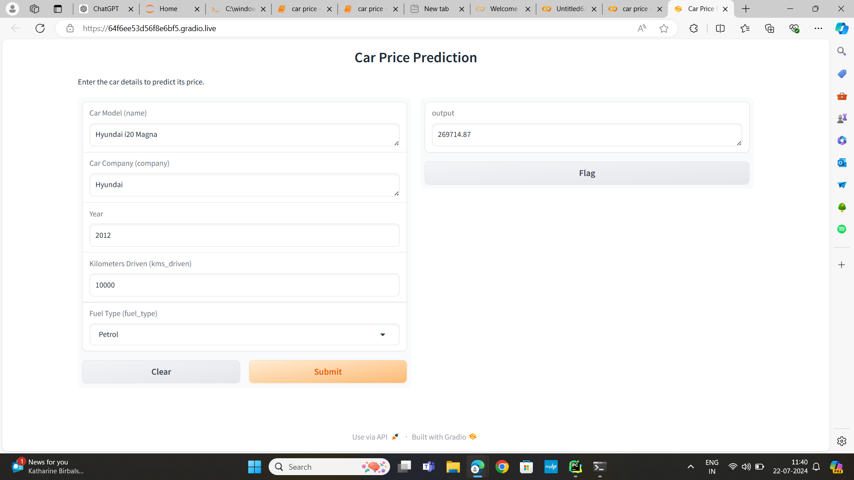
Department of Artificial Intelligence and Machine Learning www.Cambridge.edu.in

Slide 14
Conclusion
In conclusion, this project successfully addresses the challenge of predicting car prices using a combination of machine learning and web development techniques. By leveraging Flask for web application development and integrating a pre-trained linear regression model, the application provides users with a convenient platform to obtain reliable price estimates based on specific car attributes.
As a tool for both car buyers and sellers, this application facilitates informed decision-making in the automotive market, offering reliable price estimates that reflect current market conditions and specific vehicle characteristics.
Department of Artificial Intelligence and Machine Learning www.Cambridge.edu.in

Slide 15
Future Work
Looking ahead, potential enhancements could include integrating more advanced machine learning models for improved prediction accuracy, expanding the dataset to encompass a wider range of car models and years, and enhancing the user interface for enhanced usability and interactivity. By continuing to refine and expand upon this foundation, the application can further contribute to enhancing transparency and efficiency in the car sales industry.
Department of Artificial Intelligence and Machine Learning www.Cambridge.edu.in

Slide 16
References
[1] https://github.com/rajtilakls2510/car_price_predictor/tree/master/.idea
[2] https://www.geeksforgeeks.org/top-data-science-projects/#data-analysis-visualizations
[3] Sustainability | Free Full-Text | Vehicle Price Classification and Prediction Using Machine Learning in the IoT Smart Manufacturing Era (mdpi.com)
[4] Linear Regression | SpringerLink
[5] Linear Regression - an overview | ScienceDirect Topics
[6] Linear Regression in Machine learning - GeeksforGeeks
Department of Artificial Intelligence and Machine Learning www.Cambridge.edu.in

Slide 17
THANK YOU
Department of Artificial Intelligence and Machine Learning www.Cambridge.edu.in

